Slide 1

Network Layer: IPv4 Functions
Lecture 7 | CSE421 – Computer Networks
Department of Computer Science and Engineering School of Data & Science

Slide 2
Objectives
Short overview of the Network Layer
Virtual Circuits & Datagram Networks
IP Fragmentation & Reassembly
ICMP
Ping
Traceroute

Slide 3






The Network Layer
Transport segment from sending to receiving host
On sending side encapsulates segments into packets
Network layer protocols in every host, router
Router examines header fields in all IP packets passing through it
On receiving side, delivers segments to transport layer
application
transport
network
data link
physical
network
data link
physical
network
data link
physical
network
data link
physical
network
data link
physical
network
data link
physical
network
data link
physical
network
data link
physical
network
data link
physical
network
data link
physical
application
transport
network
data link
physical
network
data link
physical
network
data link
physical

Slide 4
Functions of Network Layer
Forwarding: move packets from router’s input to appropriate router output
Analogy: process of getting through a single interchange
Routing: determine route taken by packets from source to destination
Analogy: process of planning trip from source to dest
Has various routing algorithms
routing algorithm
local forwarding table
header value
output link
0100
0101
0111
1001
3
2
2
1
0111
1
3
2
value in arriving
packet’s header

Slide 5
Virtual Circuits Datagram Network

Slide 6
Connection and connection-less service
Datagram network => network-layer connectionless service
VC network => network-layer connection service
analogous to the transport-layer services, but:
service: host-to-host
no choice: network provides one or the other
implementation: in network core

Slide 7

Datagram networks
No call setup at network layer
Routers: no state about end-to-end connections
no network-level concept of “connection”
Packets forwarded using destination host address
packets between same source-dest pair may take different paths
application
transport
network
data link
physical
application
transport
network
data link
physical
1. Send data
2. Receive data

Slide 8
Virtual circuits: signaling protocols
Used to setup, maintain teardown VC
Used in ATM, frame-relay, X.25
Not used in today’s Internet
application
transport
network
data link
physical
5. Data flow begins
6. Receive data
application
transport
network
data link
physical
4. Call connected
3. Accept call
1. Initiate call
2. incoming call

Slide 9
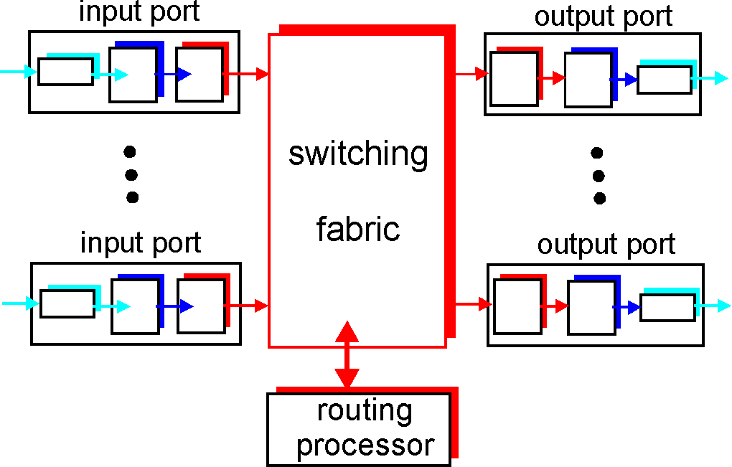
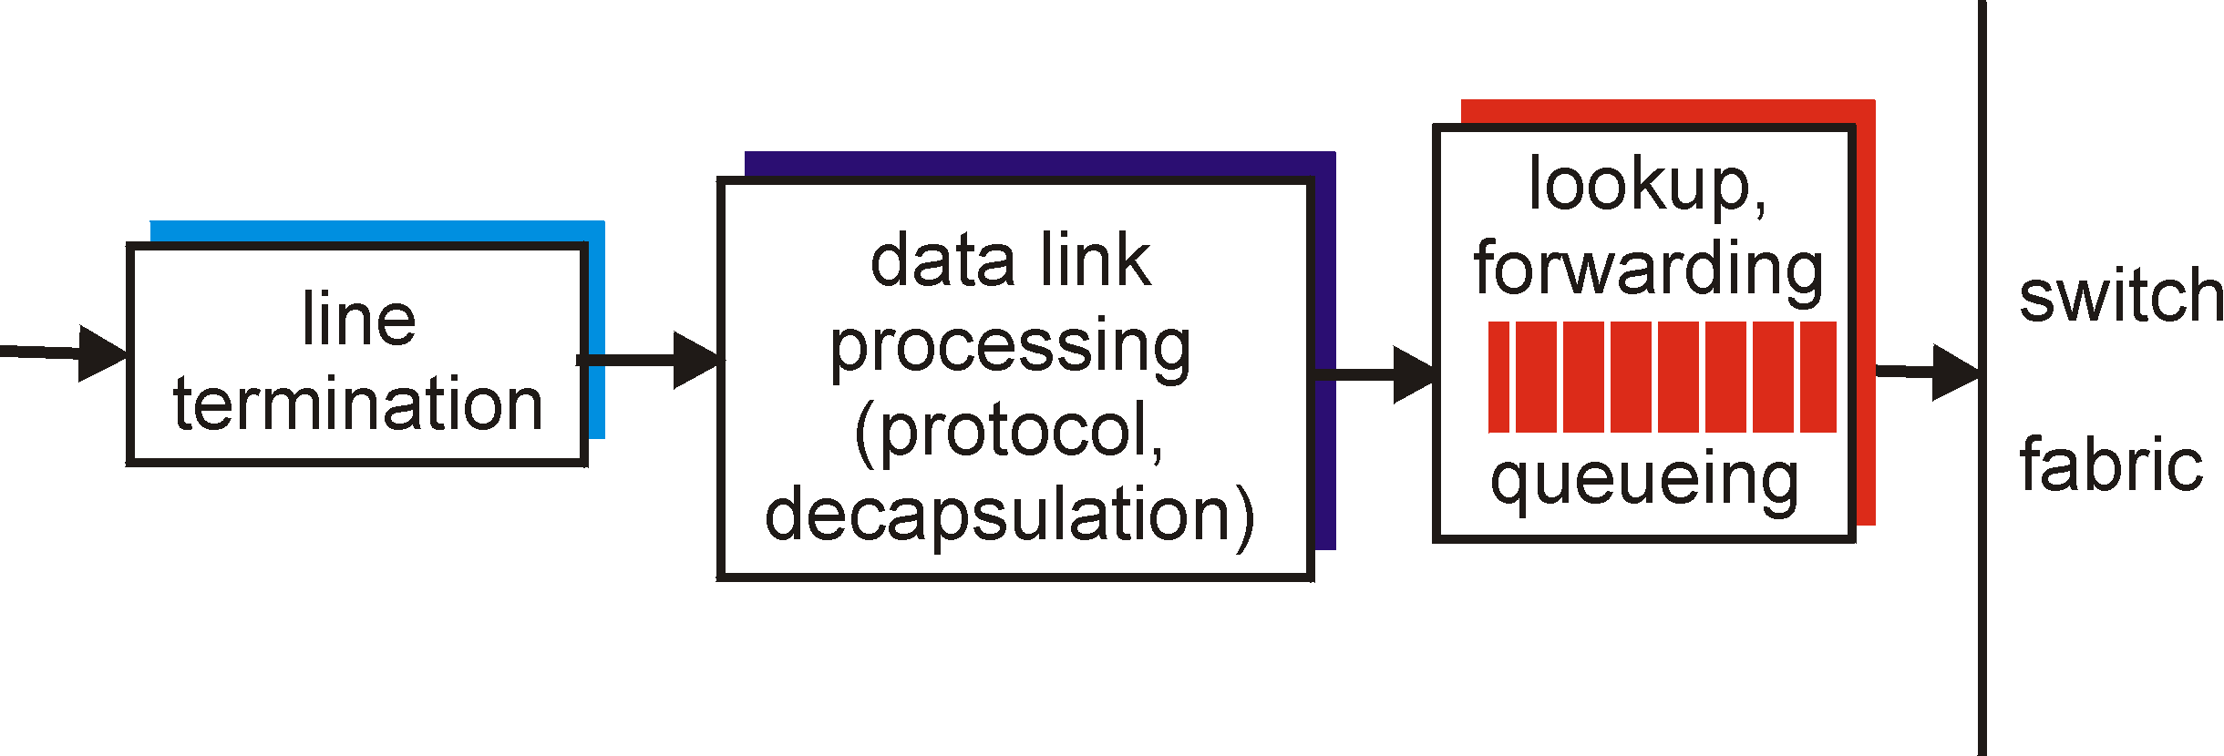
Functions of Router
Run routing algorithms/protocol (RIP, OSPF, BGP)
Forwarding datagrams from incoming to outgoing link
Decentralized switching:
Given datagram dest., lookup output port using forwarding table in input port memory
Goal: complete input port processing at ‘line speed’
Queuing: if datagrams arrive faster than forwarding rate into switch fabric
Physical layer:
bit-level reception
Data link layer:
e.g., Ethernet
see chapter 5

Slide 10
Internet Protocol

Slide 11
Internet Network Layer
Host, router network layer functions:
Transport layer: TCP, UDP
Routing protocols
path selection
RIP, OSPF, BGP
IP protocol
addressing conventions
datagram format
packet handling conventions
Network
layer
forwarding
table
ICMP protocol
error reporting
router “signaling”
Link layer
physical layer

Slide 12
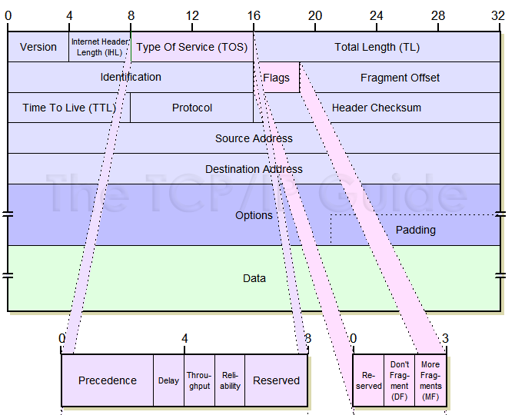
IPv4 Datagram Format

Slide 13

IP Fragmentation & Reassembly
network links have MTU (max.transfer size) - largest possible link-level frame.
different link types, different MTUs
large IP datagram divided (“fragmented”) within net
one datagram becomes several datagrams
“reassembled” only at final destination
IP header bits used to identify, order related fragments
fragmentation:
in: one large datagram (4000 bytes)
out: 3 smaller datagrams
Link MTU: 1500bytes
reassembly

Slide 14
IP Fragmentation & Reassembly
Example:
4000 Bytes of datagram
MTU = 1500 Bytes
Header + Data
Header size is usually 20 bytes
It can differ
length
=4000
ID
=x
fragflag
=0
offset
=0
One large datagram becomes
several smaller datagrams
length
=1500
ID
=x
fragflag
=1
offset
=0
1480 bytes in data field
length
=1500
ID
=x
fragflag
=1
offset
=185
offset =
1480/8
length
=1040
ID
=x
fragflag
=0
offset
=370

Slide 15
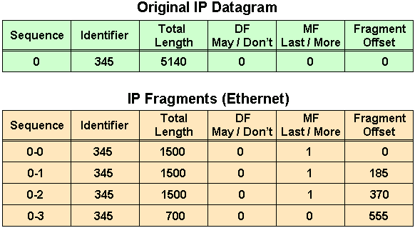
IP Fragmentation & Reassembly
MTU=20(H)+1480(D)
5140=20(H)+5120(D)
5120-1480=3640 (1st)
3640-1480=2160 (2nd)
2160-1480=680 (3rd)
680+20=700
Data Bytes | Fragment Offset
0 -1479 | 0/8=0
1480-2959 | 1480/8=185
2960-4439 | 2960/8=370
4440-5119 | 4440/8=555

Slide 16
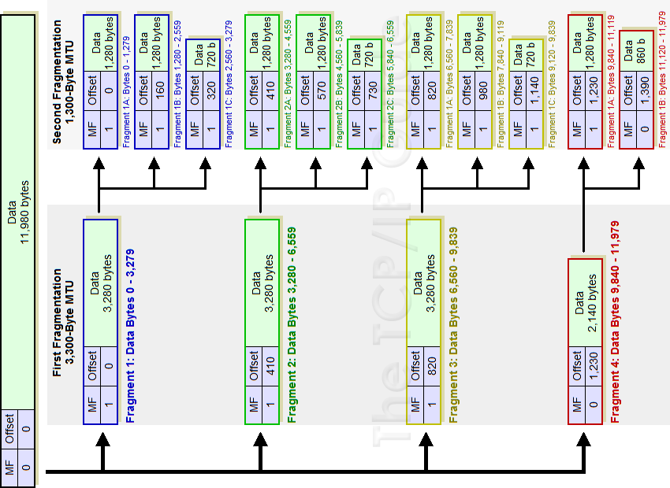
IP Fragmentation Example

Slide 17
ICMP

Slide 18
ICMP
Also known as Internet Control Message Protocol
It is chiefly used by the operating systems in IP network management and administration.
Used for
errors in the underlying communications of network applications
availability of remote hosts
network congestion
It does not carry application data, but rather information about the status of the network itself.
Example of ICMP in practice
PING
TRACEROUTE

Slide 19
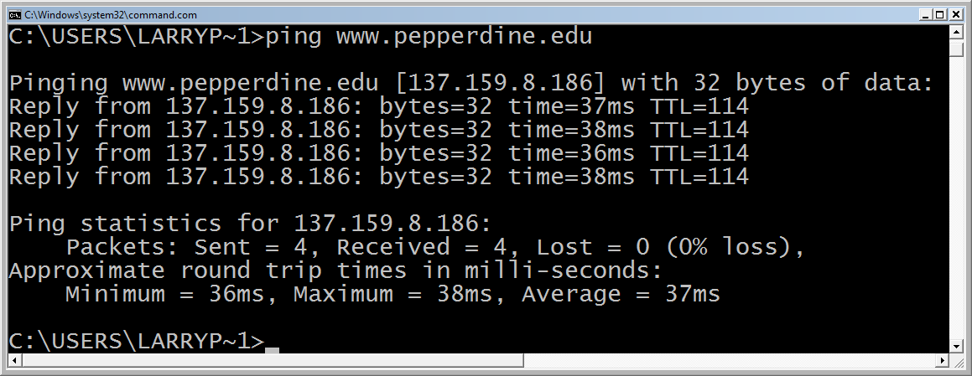
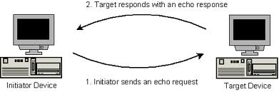
Ping
Utility used to test the reachability of a host.
Sends Internet Control Message Protocol (ICMP) echo request packets to the target host and waiting for an ICMP response.
In the process it measures the time from transmission to reception (round-trip time) and records any packet loss.

Slide 20
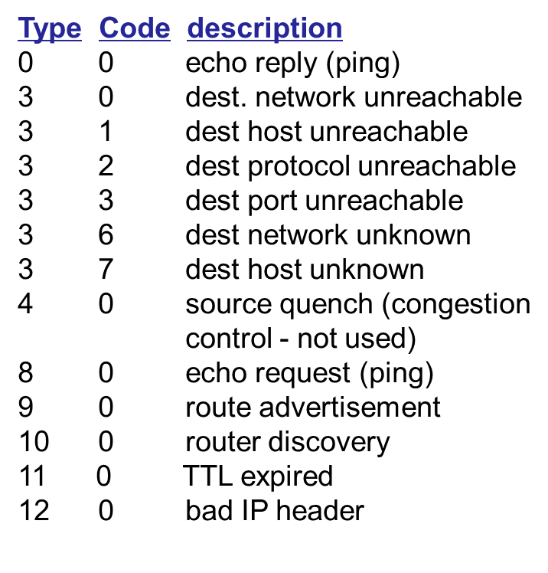
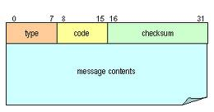
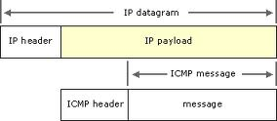
ICMP Message
ICMP message: type, code plus first 8 bytes of IP datagram causing error

Slide 21
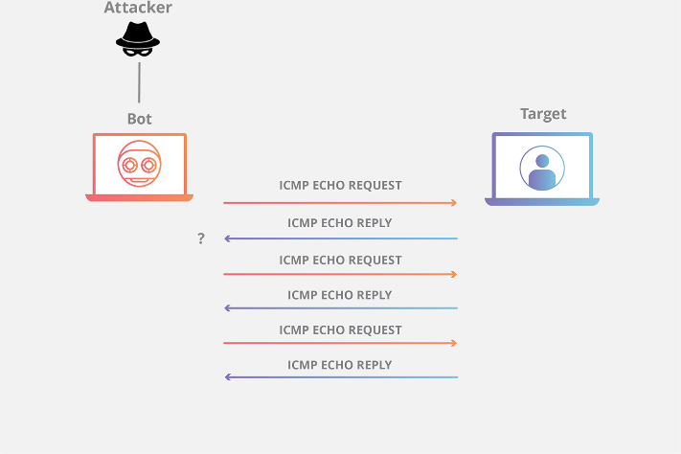
Ping Attacks
ICMP PING flood attack /DOS Attack :
It uses the ICMP echo command to flood large amounts of data packets to the victim’s computer in an attempt to overload it.
Another type of DOS Attack : Deny to give service by replying with false message.

Slide 22
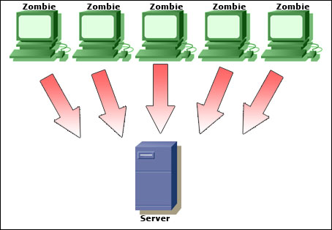
Ping Attacks
ICMP DDOS attack – Zombie Attack:
Much like the ping flood method, only multiple computers are being used. In this instance, the computers that are being used may or may not be aware of the fact that they are attacking a website or network. Trojans and viruses commonly give the hacker control of a computer, and thus, the ability to use them for attack. In this case the victim computers are called zombies.

Slide 23
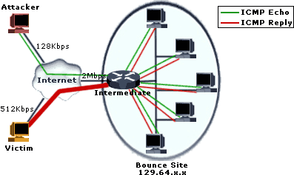
Ping Attacks
ICMP DDOS attack – Packet magnification (or ICMP Smurf):
An attacker sends forged ICMP echo packets to vulnerable networks' broadcast addresses. All the systems on those networks send ICMP echo replies to the victim.

Slide 24
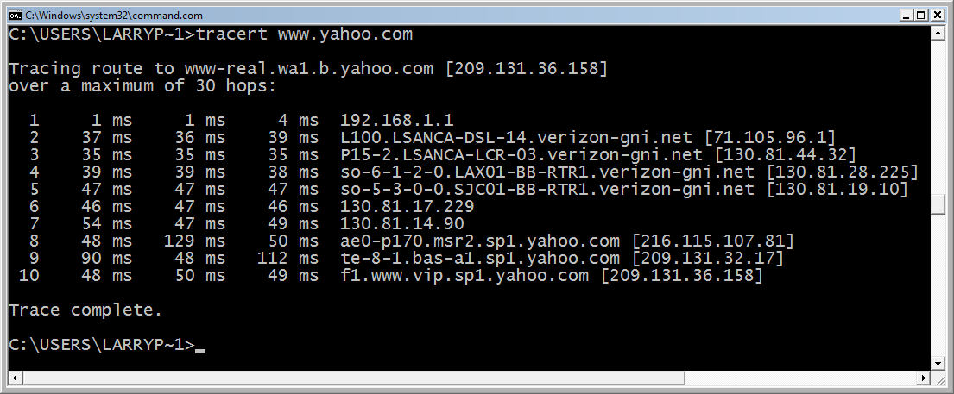
Traceroute
Tool used to trace path from source to destination host.
The IP address and domain name (if there is one) of each router is returned to the client.
Commands:
Unix: traceroute
Cisco IOS: traceroute (trace)
DOS: tracert
Hop 1: User LAN router
Hops 2-7: Verizon (ISP) network
Hops 8-10: the Yahoo LAN

Slide 25
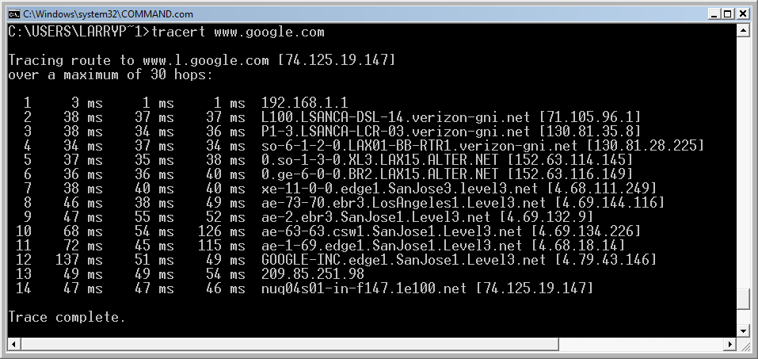
Traceroute: Another example
Hop 1: User LAN router
Hops 2-4: Verizon network (a backbone ISP)
Hops 5-6: Alternet (a backbone ISP)
Hops 7-11: Level 3 (a backbone ISP)
Hops 12-14: the Google LAN

Slide 26
Traceroute: Request Timed Out
This message indicates that the router security settings keep it from revealing its identity or the router and connection are slow.

Slide 27
Traceroute
Source sends series of UDP segments to dest
First has TTL =1
Second has TTL=2, etc.
Unlikely port number
When nth datagram arrives to nth router:
Router discards datagram
And sends to source an ICMP message (type 11, code 0)
Message includes name of router& IP address
When ICMP message arrives, source calculates RTT
Traceroute does this 3 times
Stopping criterion
UDP segment eventually arrives at destination host
Destination returns ICMP “port unreachable” packet (type 3, code 3)
When source gets this ICMP, it stops.

Slide 28
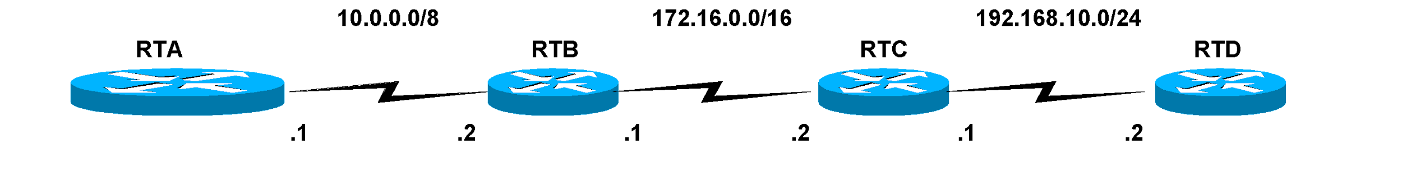
Traceroute
Layer 2 Header | Layer 3 Header | ICMP Message Echo Request (trace) |  | Layer 4 Header (UDP) | Layer 2 Trailer
*All layer 2 info | Src. IP: 10.0.0.1 Dest. IP: 192.168.10.2 TTL = 1 | Type: 8 Code: 0 | Other fields of ICMP Packet | Dest. Port: 35,000 | FCS
How it works by fooling the routers & host!
Trace uses ping (echo requests)
Traceroute sets the TTL (Time to Live) field, in the Layer 3 (IP) header, initially to “1”.

Slide 29
Traceroute
Layer 2 Header | Layer 3 Header | ICMP Message (Time Exceeded) |  | Layer 4 Header (UDP) | Layer 2 Trailer
*All layer 2 info | Src. IP: 10.0.0.2 Dest. IP: 10.0.0.1 | Type: 11 Code: 0 | Other fields of ICMP Packet | - | FCS
RTB - TTL:
When a router receives an IP Packet, it decrements the TTL by 1.
TTL ‘1’ is decremented to ‘0’
If the TTL is 0, it will not forward the IP Packet, and send back to the source with an ICMP “time exceeded” message.

Slide 30
Traceroute
Layer 2 Header | Layer 3 Header | ICMP Message (Time Exceeded) |  | Layer 4 Header (UDP) | Layer 2 Trailer
*All layer 2 info | Src. IP: 10.0.0.2 Dest. IP: 10.0.0.1 | Type: 11 Code: 0 | Other fields of ICMP Packet | - | FCS
RTA at this point
The traceroute program of the sending host (RTA) will use the source IP address of this ICMP Time Exceeded packet to display the following at the first hop.
Output of RTA: 1 10.0.0.2 4 msec 4 msec 4 msec

Slide 31
Traceroute
Layer 2 Header | Layer 3 Header | ICMP Message Echo Request (trace) |  | Layer 4 Header (UDP) | Layer 2 Trailer
*All layer 2 info | Src. IP: 10.0.0.1 Dest. IP: 192.168.10.2 TTL = 2 | Type: 8 Code: 0 | Other fields of ICMP Packet | Dest. Port: 35,000 | FCS
RTA
The traceroute program increments the TTL by 1 (now 2 ) and resends the ICMP Echo Request packet.

Slide 32
Traceroute
Layer 2 Header | Layer 3 Header | ICMP Message Echo Request (trace) |  | Layer 4 Header (UDP) | Layer 2 Trailer
*All layer 2 info | Src. IP: 10.0.0.1 Dest. IP: 192.168.10.2 TTL = 1 | Type: 8 Code: 0 | Other fields of ICMP Packet | Dest. Port: 35,000 | FCS
This time RTB decrements the TTL by 1 and it is NOT 0. (It is 1.)
So it looks up the destination IP address in its routing table and forwards it on to the next router.

Slide 33
Traceroute
Layer 2 Header | Layer 3 Header | ICMP Message (Time Exceeded) |  | Layer 4 Header (UDP) | Layer 2 Trailer
*All layer 2 info | Src. IP: 172.16.0.2 Dest. IP: 10.0.0.1 | Type: 11 Code: 0 | Other fields of ICMP Packet | - | FCS
RTC decrements the TTL by 1 and it is 0.
RTC notices the TTL is 0 and sends back the ICMP Time Exceeded message back to the source.
RTC’s IP header includes its own IP address (source IP) and the sending host’s IP address (destination IP address of RTA).
The sending host, RTA, will use the source IP address of this ICMP Time Exceeded message to display at the second hop.
1 10.0.0.2 4 msec 4 msec 4 msec
2 172.16.0.2 20 msec 16 msec 16 msec

Slide 34
Traceroute
Layer 2 Header | Layer 3 Header | ICMP Message Echo Request (trace) |  | Layer 4 Header (UDP) | Layer 2 Trailer
*All layer 2 info | Src. IP: 10.0.0.1 Dest. IP: 192.168.10.2 TTL = 3 | Type: 8 Code: 0 | Other fields of ICMP Packet | Dest. Port: 35,000 | FCS
The sending host, RTA:
The traceroute program increments the TTL by 1 (now 3 ) and resends the Packet.

Slide 35
Traceroute
Layer 2 Header | Layer 3 Header | ICMP Message Echo Request (trace) |  | Layer 4 Header (UDP) | Layer 2 Trailer
*All layer 2 info | Src. IP: 10.0.0.1 Dest. IP: 192.168.10.2 TTL = 2 | Type: 8 Code: 0 | Other fields of ICMP Packet | Dest. Port: 35,000 | FCS
RTB
This time RTB decrements the TTL by 1 and it is NOT 0. (It is 2.)
So it looks up the destination IP address in its routing table and forwards it on to the next router.

Slide 36
Traceroute
Layer 2 Header | Layer 3 Header | ICMP Message Echo Request (trace) |  | Layer 4 Header (UDP) | Layer 2 Trailer
*All layer 2 info | Src. IP: 10.0.0.1 Dest. IP: 192.168.10.2 TTL = 1 | Type: 8 Code: 0 | Other fields of ICMP Packet | Dest. Port: 35,000 | FCS
RTC
This time RTC decrements the TTL by 1 and it is NOT 0. (It is 1.)
So it looks up the destination IP address in its routing table and forwards it on to the next router.

Slide 37
Traceroute
Layer 2 Header | Layer 3 Header | ICMP Message (Port Unreachable) |  | Layer 4 Header (UDP) | Layer 2 Trailer
*All layer 2 info | Src. IP: 192.168.10.2 Dest. IP: 10.0.0.1 | Type: 3 Code: 3 | Other fields of ICMP Packet | - | FCS
RTD decrements the TTL by 1 and it is 0.
However, RTD notices that the Destination IP Address of 192.168.0.2 is it’s own interface.
Since it does not need to forward the packet, the TTL of 0 has no affect.
RTD sends the packet to the UDP process.
UDP examines the unrecognizable port number of 35,000 and sends back an ICMP Port Unreachable message to the sender, RTA, using Type 3 and Code 3.

Slide 38
Traceroute
Layer 2 Header | Layer 3 Header | ICMP Message (Port Unreachable) |  | Layer 4 Header (UDP) | Layer 2 Trailer
*All layer 2 info | Src. IP: 192.168.10.2 Dest. IP: 10.0.0.1 | Type: 3 Code: 3 | Other fields of ICMP Packet | - | FCS
Sending host, RTA
RTA receives the ICMP Port Unreachable message.
The traceroute program uses this information (Source IP Address) and displays the third hop.
The traceroute program also recognizes this Port Unreachable message as meaning this is the destination it was tracing.

Slide 39
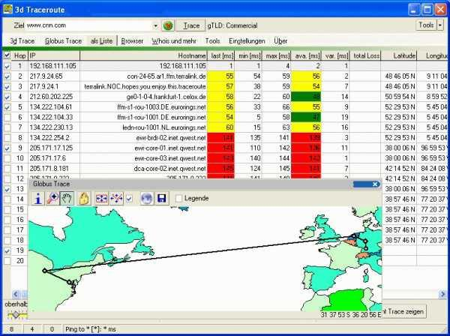
3D Traceroute

Slide 40
The End

